Slide 1
OutlookPrism
V1 Ideation and Wireframes

Slide 2
Synopsis
OutlookPrism V1 will have 5 key sub-panels (tabs):
Forecast Parameters- This tab will be used by higher management like SL/BU heads, RMG heads, CEO to input top-down forecast parameters.
Account Inputs- Will be used by Account Managers to input and/or edit account-level bottom-up forecast parameters.
Fulfilment Engine- This tab will factor in both top-down and bottom-up inputs along with Historical Data to generate a forecast.
Data Upload- This will allow the user to upload Historical Data to OutlookPrism, and/or to create and manage integrations with other tools that will allow for auto upload of Historical Data to OutlookPrism.
Dashboards- This tab will enable the users to create, edit and export graphical reports.

Slide 3
Forecast Parameters
Screen 1

Slide 4
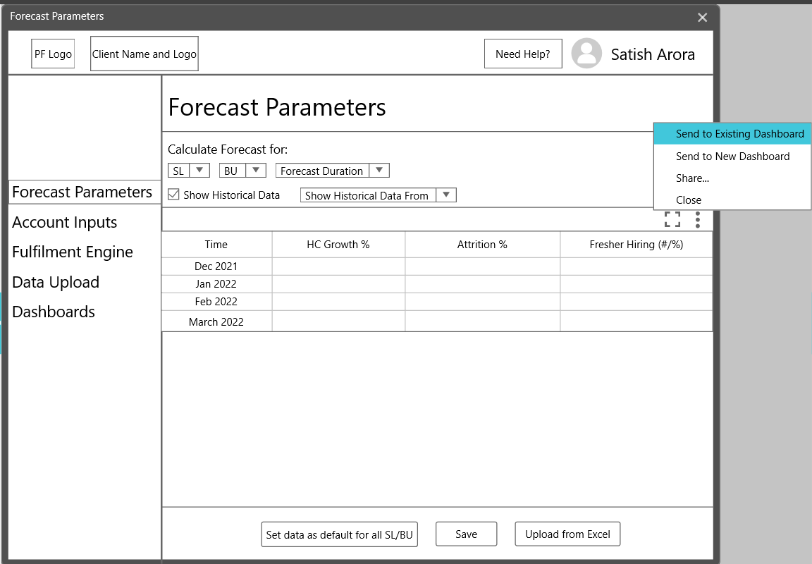

Slide 5
Forecast Parameters
Users- SL Heads, BU Heads, RMG Heads, CEO, COO
Workflow:
Select ‘SL’ and/or ‘BU’ from the drop-downs
Select ‘Forecast Duration’ from the drop-down (1-12 months)
A table will appear where the user can input:
MoM HC growth %
MoM Attrition %
Average monthly fresher hiring #
Check ‘Show Historical Data’ if you want to view the same
Select the date to only view historical data from

Slide 6
Forecast Parameters
f. Click on ‘Set as default’ button to set the data as default for all SLs and BUs g. This button will only reduce user effort so the data will still be editable h. Click on ‘Save’ button to save any changes made i. If the user tries to change the sub-panel (without saving) to navigate to another or tries to close the chrome window, a ‘warning’ dialog box will pop-up prompting the user to save changes j. Click on ‘Upload from Excel’ button to upload data for forecast months directly from Excel

Slide 7
‘Forecast Parameters’ will be used by the SL/BU leaders and Higher Management people to input “Top-Down” requirements.
Feedback- Ashwini & Som:
Add a column for ‘Revenue Growth’
This Excel like table will be used to input- ‘HC Growth’, ‘Attrition’ and ‘Fresher Hiring’ data.
Select and drag operation can be used to copy data to other cells.
‘Save button’ will be used to save the changes made in the table.
1st button when pressed will copy the data entered for the selected ‘Service Line/BU’ to all other Service Lines/BUs.
The copied data is only to reduce the user’s effort and it will be editable.
‘Upload from Excel button’ will be used to only insert data for Forecasted months from Excel.

Slide 8
Select Service Line and Business Unit from the drop down
Select Forecast Duration
Feedback-Som:
Add ‘Guideline’ data as default
1st two options will enable the users to send this grid to an existing dashboard, or to create a new dashboard and then send it there for Reporting purposes.
Share will allow sharing in .jpeg, .xls, etc. formats
‘Show Historical Data From’ will only appear if the user checks the ‘Show Historical Data’ checkbox.
User can select a date from Calendar view to only view Historical data.

Slide 9
User Access
Edit and View:
SL Heads / BU Heads- Only details concerning their own SLs/BUs, such a user can only select either SL or BU at a time
RMG leadership- They can select both SL and BU to plan on a request that has both SL and BU definite specificity
CEO, COO- Access to all SLs and BUs
Only View:
None
Configurable User Access- From Admin Panel

Slide 10
Account Inputs
Screen 2

Slide 11
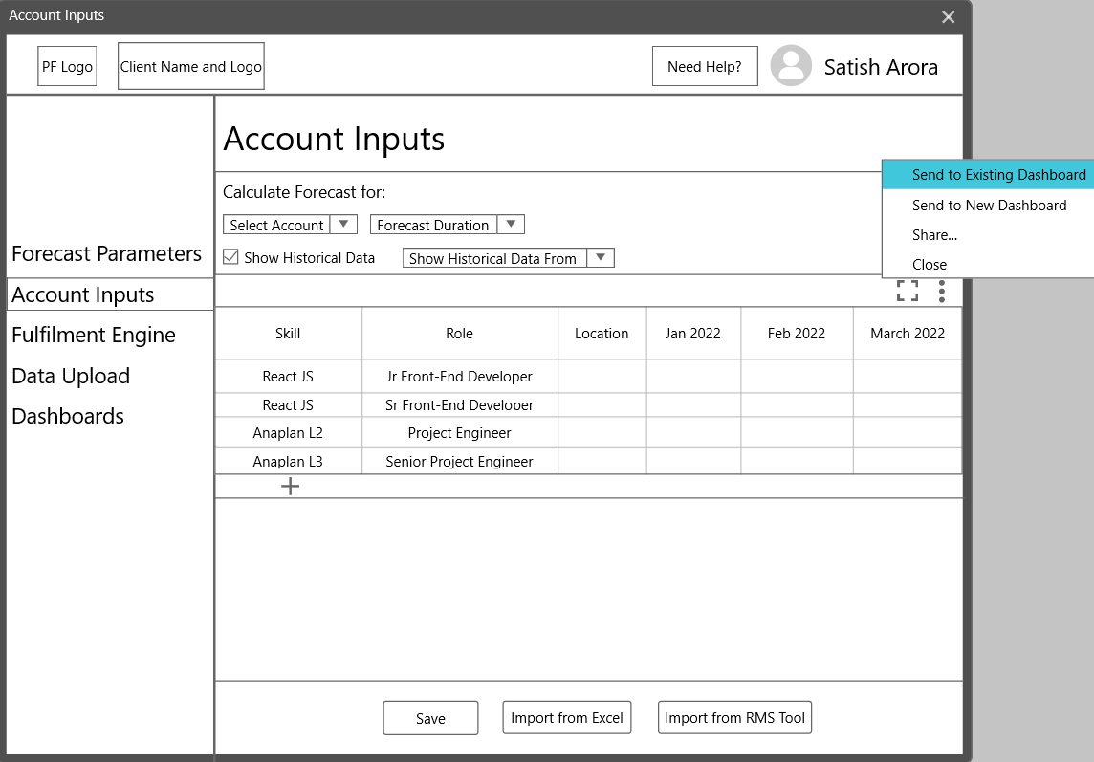

Slide 12
Account Inputs
Users- Account Managers, Project Managers
Workflow:
Select ‘Account’ from the drop-down
Select ‘Forecast Duration’ from the drop-down (1-12 months)
A table will appear where the user can input new data (using ‘+’ button) or edit existing data on:
Skill
Role
Location
Experience (?)
Forecast Months

Slide 13
Account Inputs
d. Click on ‘Save’ button to save any changes made i. If the user tries to change the sub-panel (without saving) to navigate to another or tries to close the chrome window,a ‘warning’ dialog box will pop-up prompting the user to save changes j. Click on ‘Import from Excel’ button to upload data for forecast months directly from Excel k. Click on ‘Import from RMS tool’ button to import and integrate data from an RMS tool (like- IntellisPrism)

Slide 14
Skill, Role and Location column cells will input data in the form of respective drop-downs.
‘Account Inputs’ tab will be used by Account Managers to input or edit account level demand.
Full Screen Button-
Will enter the user to a full-screen mode of the whole table.
It will make data editing process easier when multiple rows and columns trigger vertical and horizontal scrolling.
+ button will add a new row.
Save button to save changes made.
The import buttons will only be used to import Forecast data.

Slide 15
The format of the table has been kept in this way to allow the user to simply enter or edit data even when the same skills are required but for hiring for a role of different seniority (like 1st and 2nd).
Another column for ‘Experience can also be added here.’

Slide 16
User Access
Edit and View
Account Managers- Only details of their own account
CEO, COO- Access any account
Only View
Project Managers- Can view only Account that their project falls under
Configurable User Access- From Admin Panel

Slide 17
Fulfilment Engine
Screen 3

Slide 18
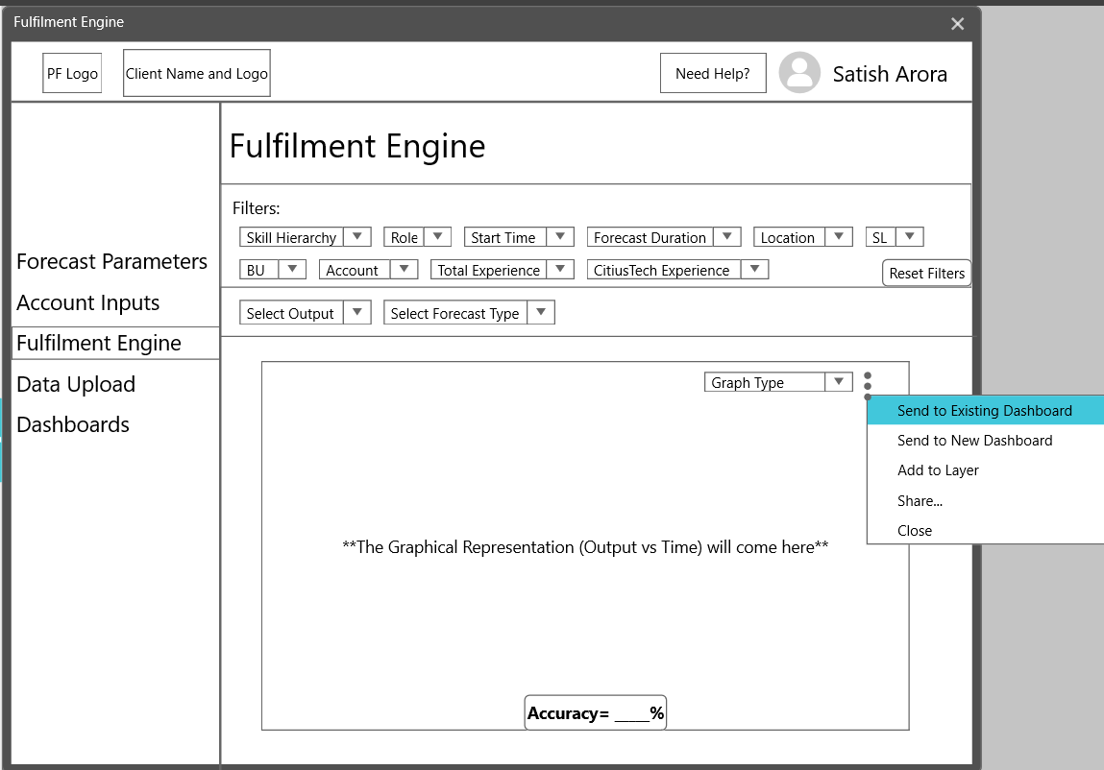

Slide 19
1st two options will enable the users to send this grid to an existing dashboard, or to create a new dashboard then send it there for Reporting purposes.
Share will allow sharing in .jpeg, .xls, etc. formats.
The user should be able to choose from the complete hierarchy of skills-
This drop down would expand from skill family (parent) to skill nodes (child) using a ‘+’ button which will be present in the drop-down.
Feedback-
Ashwini:
Add output range which will be displayed only on the graph.

Slide 20
‘Fulfilment Engine’ will factor in-
1) Forecast Inputs,
2)Account Inputs,
3)Historical Data
...to generate the Demand Forecast for the selected Time Period
Filters will allow to customize the Output vs Time graph
Reset FIlters button will allow the user to disable all filters to default values.
Outputs available:
1)Total HC
2)Billable HC
3)External Hiring
4)Bench HC
5)Utilization(?)
Add to Layer will allow to hold a graph at a place, so that it can be compared to another filter applied to the same output

Slide 21
Start Time would enable the user to select the date from which they want to view Historical data on the graph
Forecast Duration will enable the user to select the duration to be viewed on the graph as the forecast
Side note- RSL level forecast might be difficult to pull off initially, including other filters such as ‘Total Experience’ and ‘Company Specific Experience’.
These filters can be given as configurable from the Admin panel and can be switched on/off depending on capability and client demand.

Slide 22
User Access
Edit and View
SL Heads / BU Heads- Only forecasts concerning to their SL/BU
RMG leadership- Only forecasts concerning their SL/BU
Account Managers- Only forecasts of their own account
CEO, COO- Access forecast on any level
Only View
Project Managers- Can view only forecasts of the accounts that their project falls under (at AMs discretion)

Slide 23
Data Upload
Screen 4

Slide 24
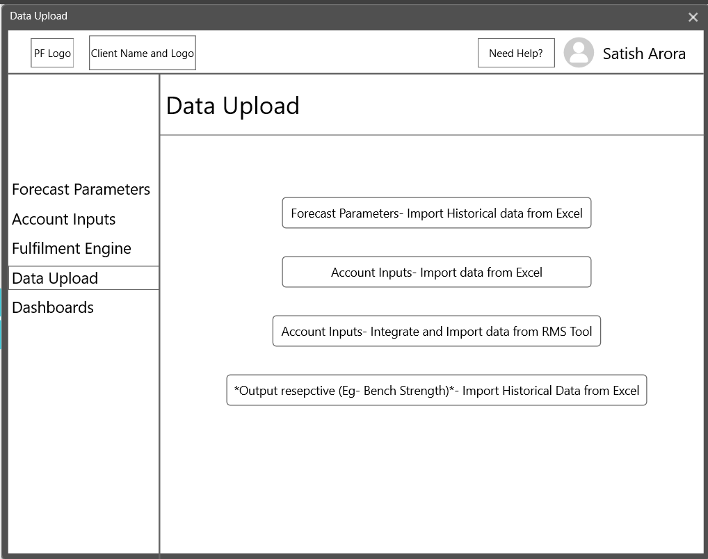

Slide 25
‘Data Upload’ tab is to upload Historical Data and for integrations that allow for automatic uploads after a defined time ‘t’.
Upload Historical data on Forecast Parameters from Excel.
Upload Account Inputs data from Excel.
Integrate with and upload Historical data on Account specific Inputs from RMS tools.
Upload Historical data on ‘Output Fields’- Bench HC, Billable HC, Total HC, etc.

Slide 26
User Access
‘Forecast Parameters’ upload button- Visible and accessible only to Users with ‘Edit’ access to Forecast Parameters sub-panel
‘Account Inputs’ upload button and integrate button- Visible and accessible only to Users with ‘Edit’ access to Account Inputs sub-panel
Output Respective data- Can be uploaded by anyone as long as it only concerns with their own SL, BU or Account

Slide 27
Dashboards
Screen 5

Slide 28
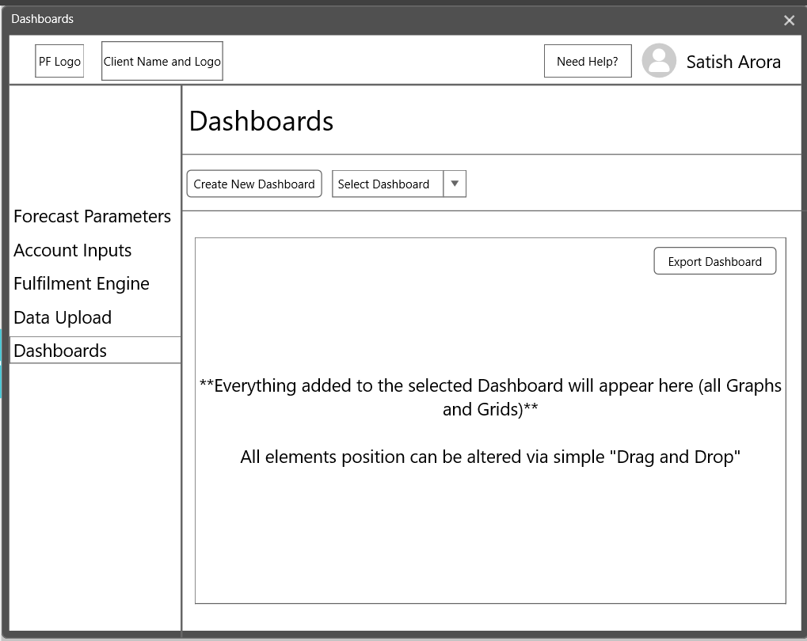

Slide 29
Button to create a new dashboard.
Button to select and edit an existing dashboard.
As mentioned- the user should be able to drag and drop the elements to different locations on the screen.
On a single left click, resize buttons would appear around the elements to allow different element sizes, as the user deems fit.
Another button called- “Add External Element” can be given to allow the user to insert images, and even other .xls grids.
Export the Dashboard in .xls format to share it with various stakeholders

Slide 30
User Access
Edit and View
SL Heads / BU Heads- Only dashboards created by them
RMG leadership- Only dashboards created by them
Account Managers- Only dashboards created by them
CEO, COO- Access any dashboard. To avoid confusion, dashboards created by (a, b, c) will be categorized
Only View
Project Managers- Can view dashboards created by their AMs at the AMs sole discretion (configurable via Admin Panel)
RMG leadership- Can view DBs created by SL heads and BU heads
SL Heads / BU Heads- Can view DBs created by RMG leadership

Slide 31
Immediate next steps
User Validation
Gather ‘Forecast Parameters’ (top-down) historical data:
SL and BU
MoM HC growth
MoM attrition
Average monthly fresher hiring (/MoM fresher hiring?)
Gather ‘Account Inputs’ (bottom-up) historical data:
Accounts
RSL data on account level

Slide 32
Immediate next steps
‘Fulfilment Engine’ historical data (only including the ones left out):
MoM Billable HC
MoM External Hiring
MoM Bench HC
MoM Utilization(?)
Why gather data beforehand? - To run ML models while we are detailing out the product

